Slide 1

The Compiler Forest
EC² Workshop on Exploiting Concurrency Efficiently and Correctly
July 7, 2012
Mihai Budiu, Microsoft Research, Silicon Valley
Joel Galenson, UC Berkeley
Gordon Plotkin, University of Edinburgh

Slide 2
Outline
Declarative parallel programming
LINQ
Massive parallel programming
Dryad and DryadLINQ
Divide-and-conquer compilation
Compilers and Partial Compilers
Modular correctness
Partial compiler (partial) correctness
Conclusions
Background
New

Slide 3

DECLARATIVE PARALLEL PROGRAMMING: LINQ

Slide 4

LINQ
Language-INtegrated Query
C#, VB, F#
~ Lisp + SQL

Slide 5
Collections
IEnumerable<T>
.Net objects of type T

Slide 6
LINQ = .Net+ Queries
Collection<T> collection;
bool IsLegal(Key);
string Hash(Key);
var results = from c in collection where IsLegal(c.key) select new { Hash(c.key), c.value}
Notes:
Language Integrated Query is an extension of .Net which allows one to write declarative computations on collections (green part).

Slide 7
LINQ Summary
Input
Where (filter)
Select (map)
GroupBy
OrderBy (sort)
Aggregate (fold)
Join

Slide 8
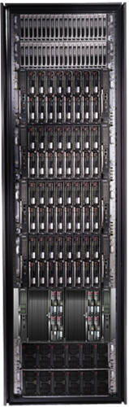
MASSIVE PARALLEL PROGRAMMING: Dryad and DryadLINQ

Slide 9

Dryad: Distributed Execution
Unix Pipes: 1-D
grep | sed | sort | awk | wc
Dryad: 2-D
grep¹⁰⁰⁰| sed⁵⁰⁰ | sort¹⁰⁰⁰ | awk⁵⁰⁰ | wc⁵⁰
9

Slide 10

LINQ
DryadLINQ
Dryad
Notes:
DryadLINQ adds a wealth of features on top of plain Dryad.

Slide 11

Distributed Collections
Partition
Distributed Collection

Slide 12

DryadLINQ = LINQ + Dryad
Collection<T> collection;
bool IsLegal(Key k);
string Hash(Key);
var results = collection .Where(c => IsLegal(c.key)) .Select(c => new { Hash(c.key), c.value})
Local code
Dryad computation
Data
collection
C#
C#
C#
C#
results
Notes:
DryadLINQ translates LINQ programs into Dryad computations:
- C# and LINQ data objects become distributed partitioned files.
- LINQ queries become distributed Dryad jobs.
- C# methods become code running on the vertices of a Dryad job.

Slide 13
Homomorphisms
f( )=
o
Select(x => f(x))
o

Slide 14
Aggregation
f( , )=
f is associative (commutative)
o
Aggregate((x,y) => f(x,y))
o

Slide 15
(Co)GroupBy
o
GroupBy(x => K(x))
PartitionBy(x => K(x))
o
GroupBy(x => K(x))
Equal under
permutation
o

Slide 16
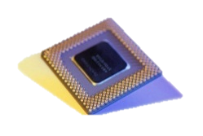
Nested Parallelism
Core
Machine

Slide 17

DryadLINQ
Rich data model: collections of .Net objects
Not just SQL tuples
Expressive programming model
Not just Map-Reduce
Strong typing
Powerful user-defined functions
Arbitrary .Net code
Tight integration with .Net and tools

Slide 18
DryadLINQ Architecture
DryadLINQ
Cluster
ParallelApply
LINQ-to-Objects
Nectar
query
plan
LINQ-to-SQL
Stena
PLINQ

Slide 19
Outline
Declarative parallel programming
LINQ
Massive parallel programming
Dryad and DryadLINQ
Divide-and-conquer compilation
Compilers and Partial Compilers
Modular correctness
Partial compiler (partial) correctness
Conclusions
You are here
Background
New

Slide 20
Divide ET IMPERA: Partial Compilers

Slide 21
Modularizing DryadLINQ
Cluster LINQ Query
Cluster compiler
Machine LINQ Query
Machine compiler
Core LINQ Query
Core compiler

Slide 22
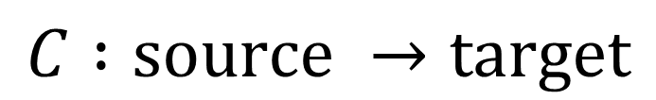
Compilers
S
T
Compiler
$$C :source →target$$
Notes:
Mention that plans can be queries.

Slide 23
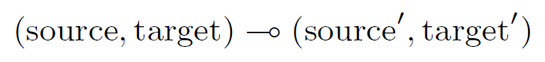
Partial compilers
source
target
G generate
Partial
compiler
R
reduce
source’
target’
Child
Compiler
$$PC :source →\left(source^{′} × \left(target^{′}→target\right)\right)$$
Notes:
Composition is also a compiler/partial compiler.

Slide 24
Internals
source
target
generate
local
local
leftover
source’
target’
Child
Compiler

Slide 25
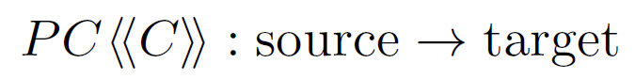
Compiler Composition
source
target
PC
source’
target’
C

Slide 26
Partial Compiler Composition
source
target
PC
target’
source’
PC’
source’’
target’’

Slide 27
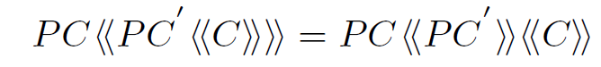
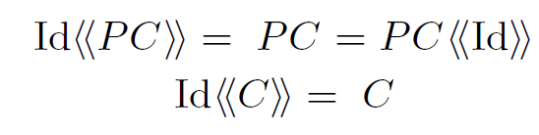
Composition Laws
Id

Slide 28
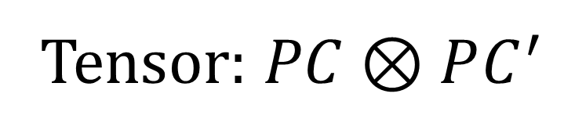

Compilers as First-Class Objects
$$⊗$$
Tensor: $PC⊗PC^{′}$

Slide 29
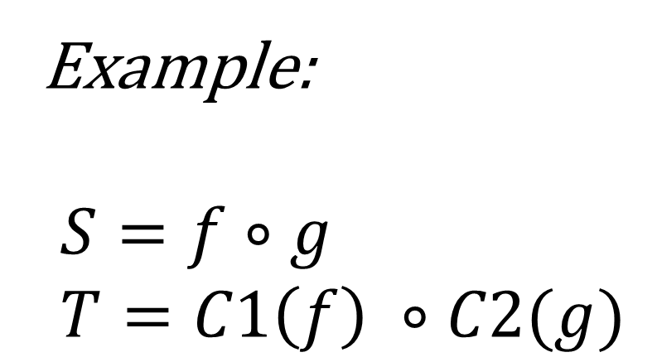
Multiple Children
S
T
Example:
$$S=f∘g \\ T=C1\left(f\right) ∘C2(g)$$
SEQ
C1
C2

Slide 30
Conditional
if gpu
gpu : source -> bool
GPU
CPU

Slide 31
Case
case
Select
GroupBy
Aggregate

Slide 32
Star
source*
target*
*
C

Slide 33
Patching Bugs
if bug
SIMPLE
OPT

Slide 34
A LINQ Compiler
SEQ
*
case
Select
GroupBy
Aggregate

Slide 35
A Multi-Core LINQ Compiler
SEQ
S
MC
MC
o
T
T
*
o
T
case
Select
GroupBy
Aggregate

Slide 36
A Distributed, Multi-Core LINQ Compiler
SEQ
Cluster
MC
*
case
Select
GroupBy
Aggregate

Slide 37
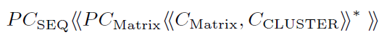
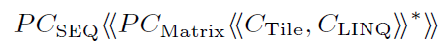
A Distributed Matrix Compiler
Matrix -> sets of tiles
Distributed LINQ
Matrix operations
LINQ
Tile operations

Slide 38
M1.Times(M2).Plus(M3)
PC_{SEQ}
PC_{MATRIX}
M1
C_{LINQ}
Join.
GroupBy. Select(
Aggregate)
PC_{TILE}
*
PC_{MATRIX}
C_{LINQ}
PC_{TILE}
Concat
GroupBy. Select(
Aggregate)
+
PC_{TILE}
M2
+
M3

Slide 39
Outline
Declarative parallel programming
LINQ
Massive parallel programming
Dryad and DryadLINQ
Divide-and-conquer compilation
Compilers and Partial Compilers
Modular correctness
Partial compiler (partial) correctness
Conclusions
Background
You are here now
New

Slide 40
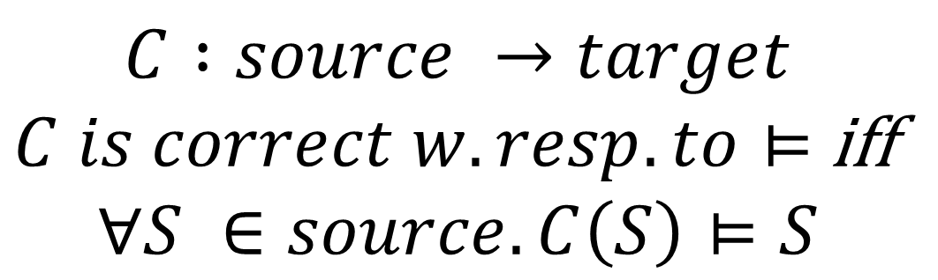
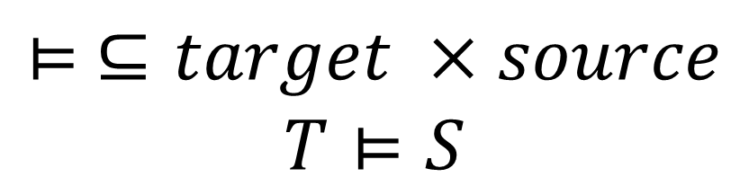
Correctness Definition
$$⊨ ⊆target ×source \\ T⊨S$$
T implements the meaning of S
S
T
$$C :source →target$$ $C is correct w. resp. to⊨$iff $$∀S ∈source.C\left(S\right)⊨S$$
C

Slide 41
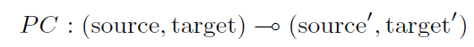
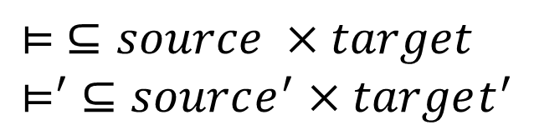
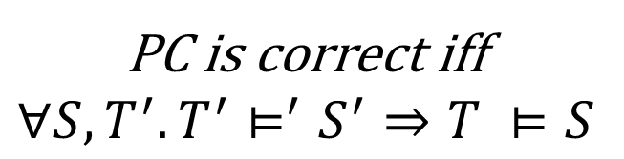
Partial Compiler Correctness
S
T
$$⊨ ⊆source ×target \\ ⊨^{′} ⊆source^{′}×target^{′}$$
G
PC is correct iff $$∀S, T^{′}.T^{′}⊨^{′}S^{′}⇒T ⊨S$$
R
S’
T’

Slide 42
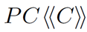

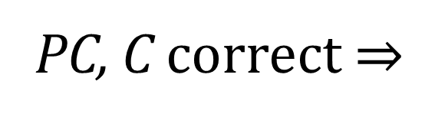
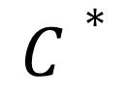
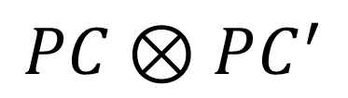
Correctness Theorems
PC, C correct$⇒$
correct
$$PC⊗PC^{′}$$
correct
$$C∗$$
correct
etc.

Slide 43
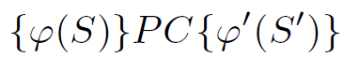
Partial Correctness
Correct only for some programs
{Precondition}
{Postcondition}
Correct only for some programs
Generated sub-programs satisfy this predicate

Slide 44
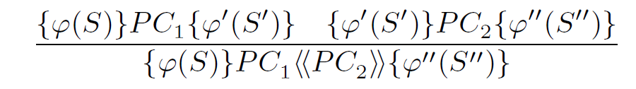
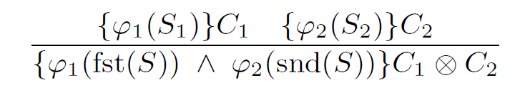
Hoare Logic for Compiler Constructions

Slide 45
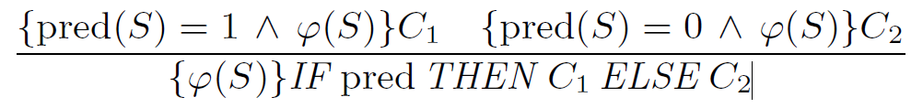
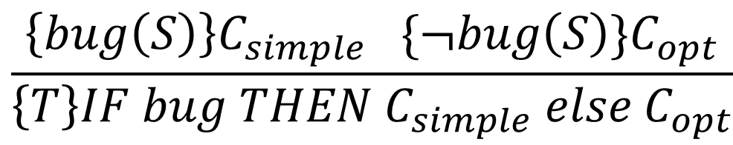
Conditionals
if bug
$$\frac{\left\{bug\left(S\right)\right\}C_{simple} \{¬bug\left(S\right)\}C_{opt}}{\left\{T\right\}IF bug THEN C_{simple} else C_{opt}}$$
SIMPLE
OPT
Totally correct compiler from partially correct parts!
Notes:
Emphasize that the GPU can be partially correct but the whole compiler is totally correct.
Quickly describe the formula.

Slide 46
Partially Correct Only
SEQ
Cluster
{Mon(S)}C
MC
All aggregations are monoidal
(associative and commutative).
*
case
Select
GroupBy
Aggregate

Slide 47

SUMMARY

Slide 48
LINQ: Computing with collections
Input
Where (filter)
Select (map)
GroupBy
OrderBy (sort)
Aggregate (fold)
Join

Slide 49
LINQ
DryadLINQ
Dryad
Notes:
DryadLINQ adds a wealth of features on top of plain Dryad.

Slide 50
Partial compilers
G generate
R
reduce
Child
Compiler
Notes:
Composition is also a compiler/partial compiler.

Slide 51
Compilers as first-class objects
*
*
Star
Iteration
if p
else
Tensor
Conditional

Slide 52
A Hoare Logic for Compilers
{Precondition}
{Postcondition}
if bug
SIMPLE
OPT

Slide 53
Compilers from Parts
SEQ
Cluster
MC
*
case
Select
GroupBy
Aggregate

Slide 54
BACKUP SLIDES

Slide 55

Summary
LINQ: computing with collections
Dryad: distributed dataflow
DryadLINQ: distributed LINQ
Partial compilers: compile parts of a program
Structured programming with compilers
Complex compilers from simple pieces
Hoare logic for partial compilers

Slide 56




Fault Tolerance
Notes:
Vertex failures and channel failures are handled differently.

Slide 57
Virtualized 2-D Pipelines
Notes:
This is a possible schedule of a Dryad job using 2 machines.

Slide 58
Virtualized 2-D Pipelines

Slide 59

Virtualized 2-D Pipelines

Slide 60
Virtualized 2-D Pipelines

Slide 61
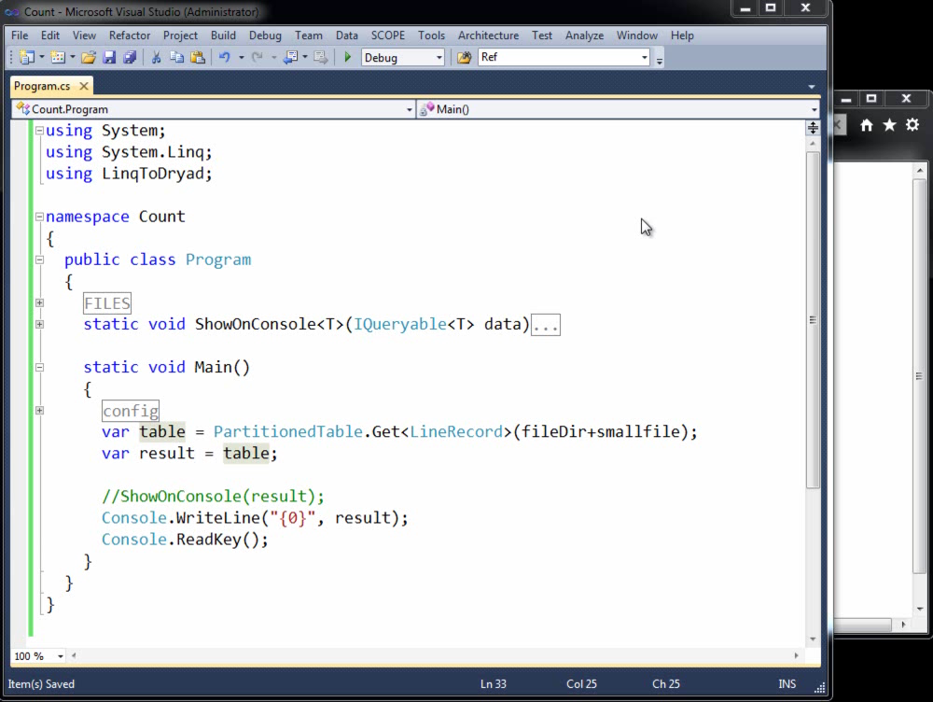

Slide 62
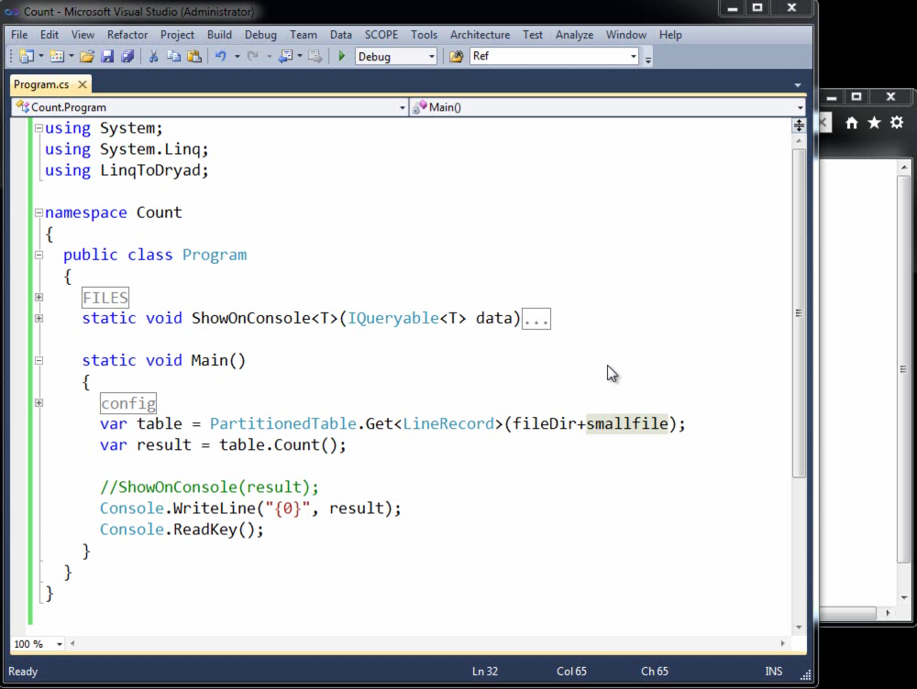

Slide 63
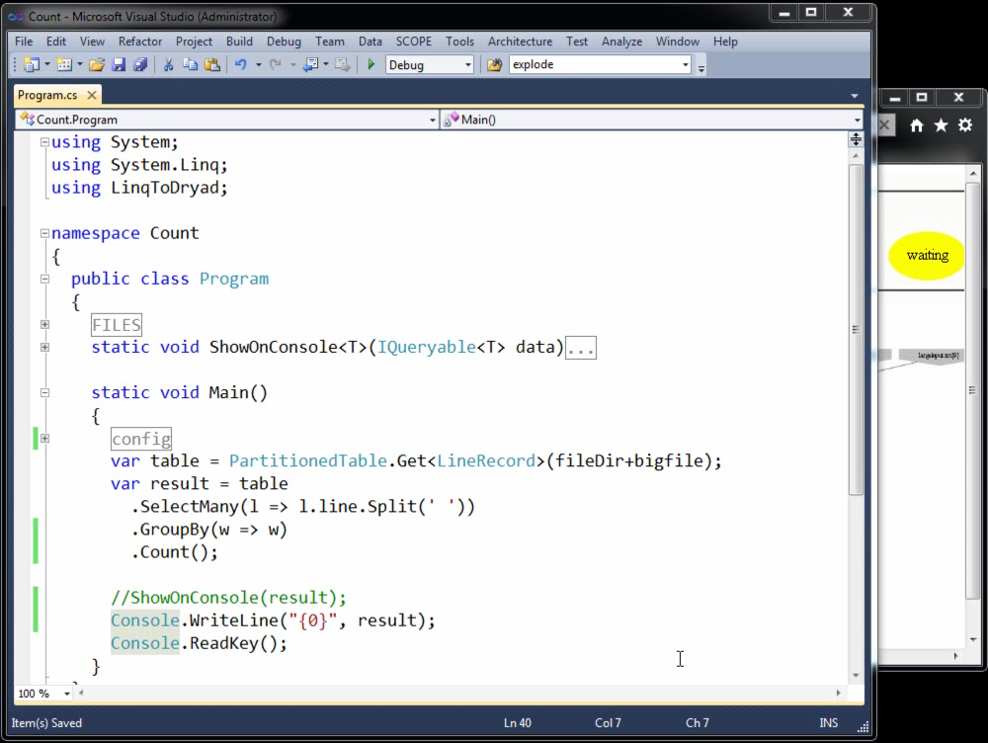

Slide 64
